Slide 1
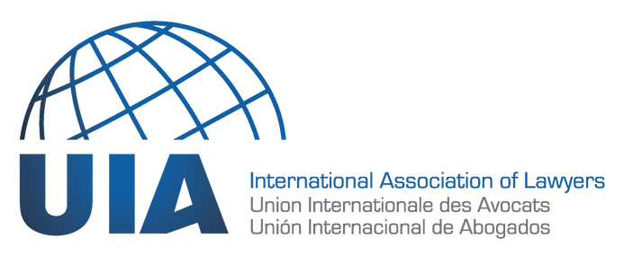
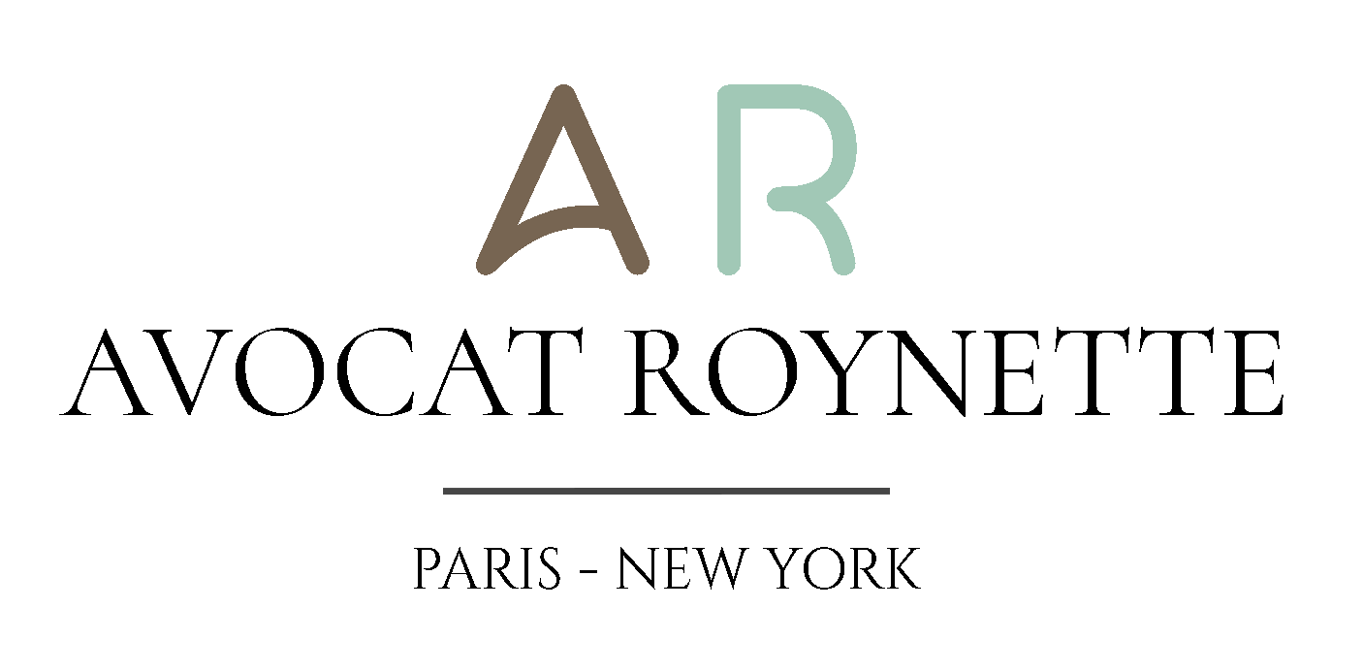
II- Coverage of civil liability for climate change under corporate insurance policies from a comparative law perspective
Karel Roynette, Esq. - Paris & New York Attorney-at-law
WWW.UIANET.ORG

Slide 2
Introduction: what is liability for climate change?
Claim
1st scenario : coverage of pollution caused in a sudden manner, especially under the so-called hostile fire theory
Factual situation
Insurance application
2nd scenario: coverage of gradual pollution by greenhouse gas emissions causing climate change
Facts
Proceedings
Insurance scope
3rd scenario: Coverage of contributing behavior to climate change that leads to human rights violations
Principle
Additional duty of due diligence of holding companies
Insurance scope
WWW.UIANET.ORG

Slide 3
1. Introduction: what is liability for climate change?
Liability for climate change involves human-made greenhouse gas emissions which result in natural disasters causing harm to people or human rights violations
For instance, this includes mega fires, extensive drought, extra floods, stronger hurricanes
WWW.UIANET.ORG

Slide 4
2. Claim
How is such liability for climate change covered under environmental damage insurance policies from a comparative law perspective (France/EU v. US)?
I would not deal with such litigation brought against governments, as it does not relate to insurance generally speaking.
WWW.UIANET.ORG

Slide 5
3.1. 1st scenario : coverage of pollution caused in a sudden manner, especially under the so-called hostile fire theory
Factual situation
This concerns a fire that spreads to neighboring properties as a result of the occurrence of projections of sudden pollution of flammable substances on these properties.
As a result of climate change, such fires may further increase and even result in more serious damage such droughts. (E.g., fires in California, Southern Europe…).
WWW.UIANET.ORG

Slide 6
3.2. 1st scenario : coverage of pollution caused in a sudden manner, especially under the so-called hostile fire theory
Insurance application
In the US, coverage could then be available as an exception to the pollution coverage exclusion in CGL insurance policies.
In most EU countries, it would be deemed to be directly covered under CGL insurance policies. In France, it would be covered in the context of property damage policies.
Therefore, environmental damage caused by such surrounding fires, even local droughts, would be granted coverage.
WWW.UIANET.ORG

Slide 7
4.1. 2nd scenario: coverage of gradual pollution by greenhouse gas emissions causing climate change
Facts
This scenario matches a noticeable case pending in Germany referred to as Lliuya v RWE AG.
It involves a local community in Peru which received floods from a nearby glacier after it started to melt as a result of greenhouse gases.
The Peruvian community sued the German industrial company based on its share of greenhouse gas emissions since its foundation during the industrial revolution in the 19th century.
They seek compensation for the flooding damage from the German company.
WWW.UIANET.ORG

Slide 8
4.2. 2nd scenario: coverage of gradual pollution by greenhouse gas emissions causing climate change
Proceedings
After the trial court dismissed the case for lack of admissibility, the Court of Appeals has now reinstated the case.
The appellate panel especially deemed that the new scientific theory of attribution could determine the German company’s share of greenhouse gas emissions over time.
Therefore, there could be determined its apportionment of liability for the flooding damage suffered by the Peruvian community, which is now to be decided on the merits by German courts.
WWW.UIANET.ORG

Slide 9
4.3. 2nd scenario: coverage of gradual pollution by greenhouse gas emissions causing climate change
Insurance scope
Environmental impairment liability insurance policies (also called premises pollution liability insurance policies) may apply for such gradual pollutions (unlike CGL insurance polices which provide for their coverage exclusion).
This may be more so in the EU where such coverage does exist on the insurance market, rather than in the US where such policies are less common.
However, defenses will most certainly be available to insurers (policies deemed null and void based on a lack of risk disclosures, coverage exclusion based on knowledge of the risk, the undertaking of a usual business, the development risk…)
WWW.UIANET.ORG

Slide 10
5.1. 3rd scenario: Coverage of contributing behavior to climate change that leads to human rights violations
Principle
This is based on the case in the Netherlands called Milieudefensie et al. v. Royal Dutch Shell plc. which, in 2021, ordered Shell to reduce its greenhouse gas emissions because they violated the human rights to life and respect for private and family life.
At the insurance level, the cost of restoring victims to their human rights should be subject to the same coverage by:
CGL insurance polices in the event of a sudden occurrence.
Environmental impairment liability insurance policies in the event of a gradual occurrence.
WWW.UIANET.ORG

Slide 11
5.2. 3rd scenario: Coverage of contributing behavior to climate change that leads to human rights violations
Additional duty of due diligence of holding companies
A complementary hypothesis concerns the liability of holding companies under their duty of due diligence to prevent their subsidiaries/partners from committing environmental or human rights violations.
French law establishes such a liability of holding companies for breach of their duty of due diligence to ensure that their subsidiaries do not harm the environment and human rights (cf. L.225-102-5 of the French Commercial Code, see also Envol Vert et al. v. Casino pending before the trial court of Saint-Etienne).
A draft European directive plans to extend it to the whole of the EU.
WWW.UIANET.ORG

Slide 12
5.3. 3rd scenario: Coverage of contributing behavior to climate change that leads to human rights violations
Insurance scope
The liability of holding companies under their duty of due diligence lies in their own failure to prevent environmental damage by their subsidiaries contributing to climate change.
Therefore, this liability would be subject to the holding company’s D&O insurance policy (and not the CGL insurance policy), insofar as this policy covers the liability resulting from the directors and officers’ management of the holding company also including the duty of due diligence vis-à-vis the subsidiaries (unless in the event of an exclusion of environmental damage).
WWW.UIANET.ORG

